Slide 1
-A Java game built with oop
Tic Tac Toe

Slide 2
Project Partners:
Azwad Anjum Islam Dipto (Roll – 01)
Redwan Ahmed Rizvee(Roll – 09)

Slide 3
Introduction
A very famous and renowned paper game.
We made a Computer Version
It’s an online Game!!!!
It’s an Intelligent version of the famous game.

Slide 4
What We Used
Java GUI Swing Package
Java Awt Applet
Java net package
Java io format
Lucrative images from the net
A threaded program

Slide 5
What is “Tic Tac Toe”
A two player game
Both player play sequentially
Whoever first matches diagonally or horizontally or vertically with his move wins.

Slide 6
Our “Tic Tac Toe”
Normal all rules of the game been followed.
But it’s now a computer and multiplayer version.
With little bit Intelligence of future winner prediction and move simulation.

Slide 7
Algorithmic Basic
First We choose who will give first move, Server/Client
Then we take the move and sent a “bitString” to the opposite player.
He formats his moves and simulates his frame and design it.
And after giving his move he again sends this same thing to the opposite player. He does the same thing again.

Slide 8
Games Specialty
Every move is simulated carefully. Whose move is good, who has given a clever move. And sudden move when someone wins game stops after showing the winner.
A little bit intelligence been used.

Slide 9
Image’s Specialty
Every person’s move shows changes in his frame, where he has given his move.
Winning is showed with a different image

Slide 10
Move Specialty
Every move is simulated with direction array to predict future winner and to show how good that move is.
It’s a all possible simulation algorithm to show the best move it’s shown on the up of the both server and client frame.

Slide 11
Classes and methods
Main Class: Tic Tac Toe
Beginning Class: Menu create
Starting Game: ServerOn() or SecondServeron()
FirstPlayerServer: Server gives first move
ClientTicTacToe: Client gives second move
SecondPlayerServer: Server gives second move
ClientFirstPlayer: Client first move

Slide 12
FirstPlayerServer/SecondPlayerServer - Methods
CreationOfWindow()
Work()
bitStringFormatingAndSend()
perfectingTheScenario()
riImageLoading()
ShowWinnerOne()
ShowWinnerTwo()

Slide 13
ClientTicTacToe
Creation()
Work()
bitStringFormatingAndSend()
perfectingTheScenario()
riImageLoading()
ShowWinnerOne()
ShowWinnerTwo()

Slide 14
Intelligence
simpleMoveChecking();
simpleMoveCheckingDistantVersion();
simpleMoveCheckingWithMultipleWaysOfWin();
adjecentVersionWithMultipleWaysOfWin();
adjacentAndDistant();

Slide 15
WinnerDeterminator
Determines the winner who has already won with his move.

Slide 16
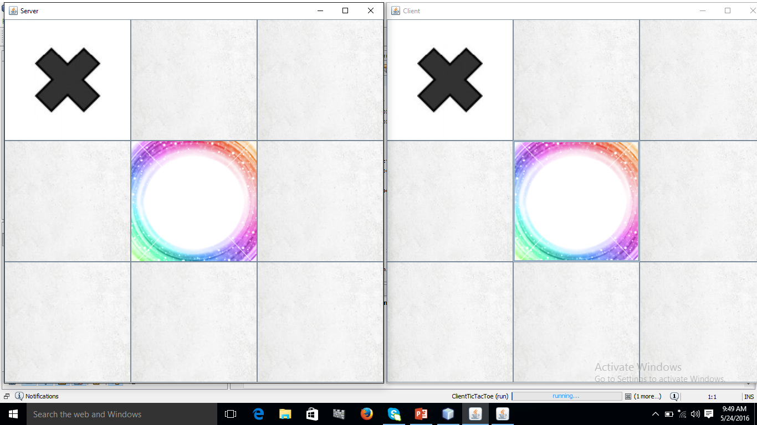
Some Images From the Game

Slide 17
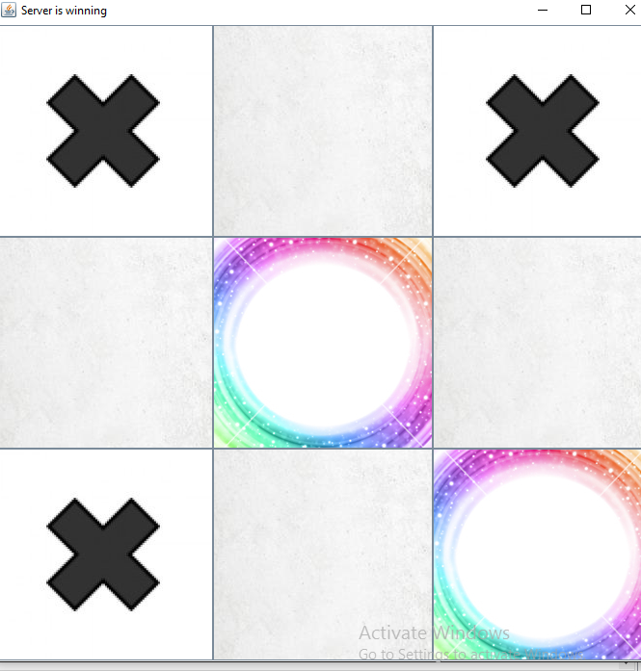
Intelligence

Slide 18
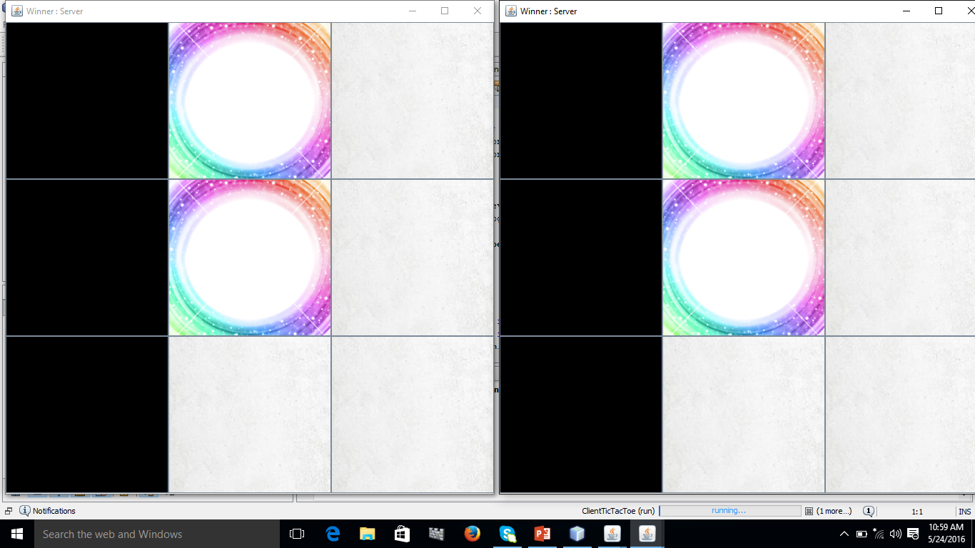
Winner

Slide 19
Computer VS Player
8 by 8 Tic Tac Toe

Slide 20
Most Attractive Parts
Artificial Intelligence of Computer
The Best move to win
A little bit flavor of the traditional chess game

Slide 21
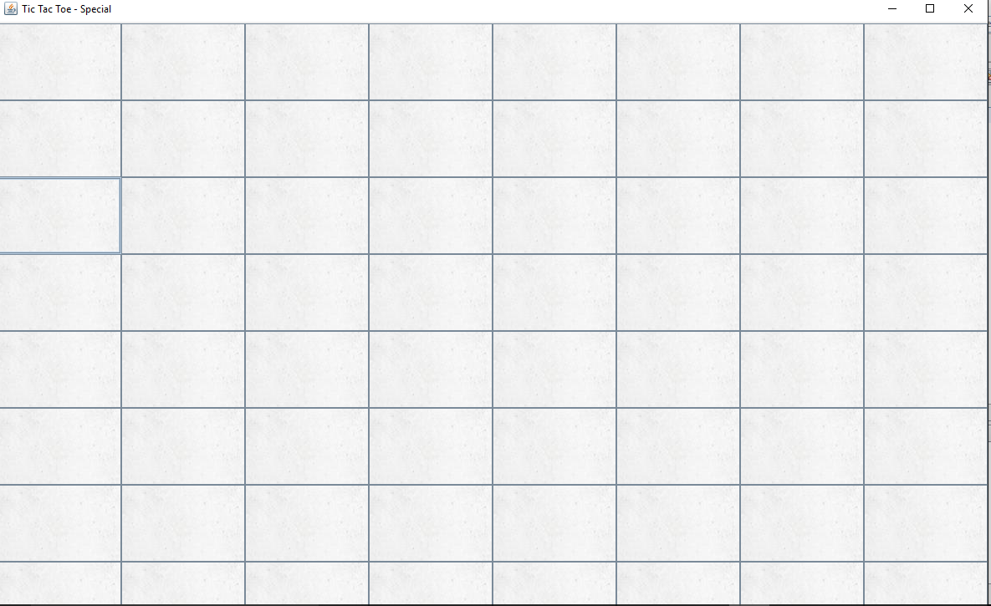
8 by 8 Board

Slide 22
Winning ways
Horizontal 8 consecutive rectangles
Vertical 8 Consecutive rectangles
Diagonal 8 rectangles
Using 2 rows making 8 consecutive rectangles
Using 4 rows 8 consecutive rectangles
The first object who will make up the condition will be the winner.

Slide 23
Little bit Artificial Intelligence
Giving the best possible way of winning.
Choosing the best grid to make the computer in most better position in the game.
Computer simulates every move and choose the best move for winning.

Slide 24
8 by 8’s Specialty
Totally made from artificial intelligence.
Computer Vs Human
The best Chooser will be the winner.

Slide 25
Problems We faced
Server’s move is been seen on the screen a little bit late. For Some reason we couldn’t find jbutton’s setIcon() method is not working properly.

Slide 26
Resources
TutorialsPoint
Oracle Java
You tube
Herbert Schildt – Complete Reference to Java

Slide 27
Thank You

